Slide 1
Analysis of Fire Fighting Methods using Cellular Automaton Modeling
Matthew Wilson, Brent D. Foy
Notes:
Put on physics department and psychology department

Slide 2
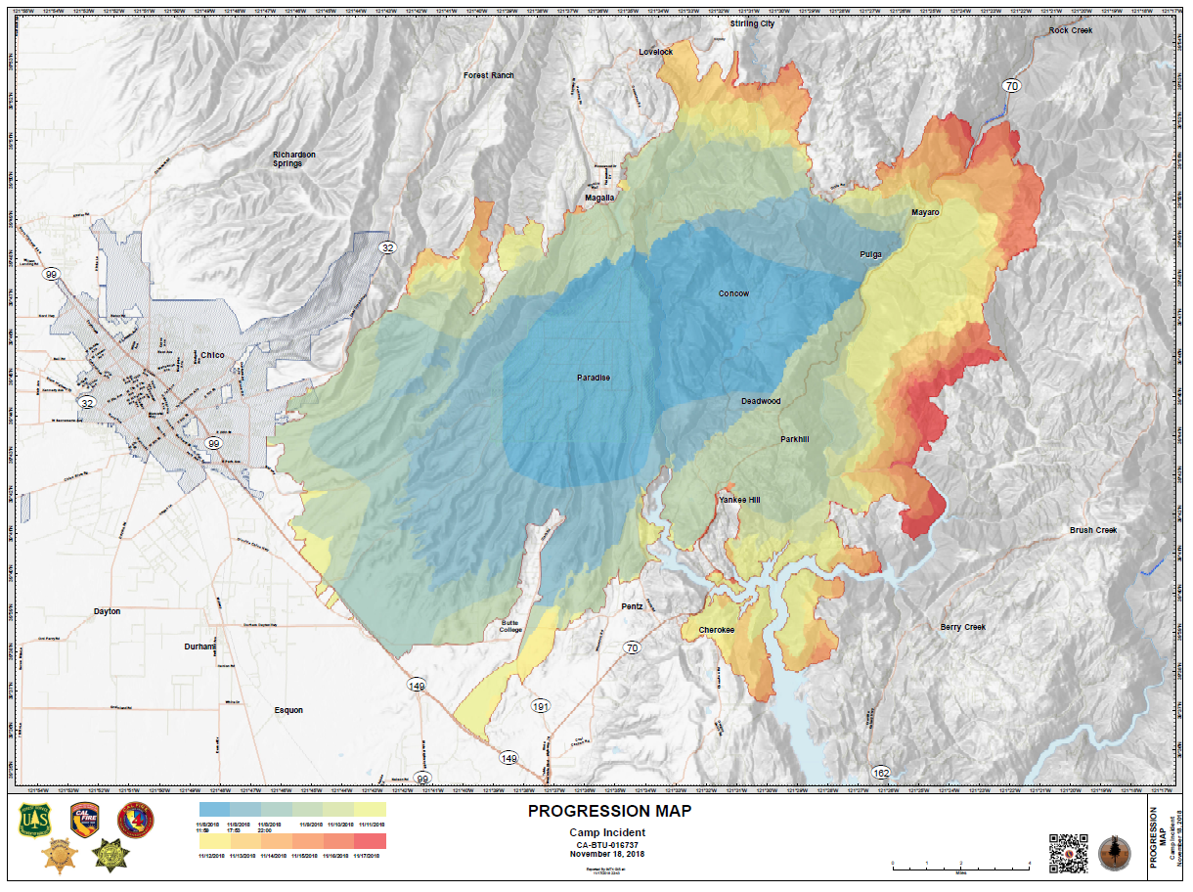
Forest Fires and their Effects
Camp Fire Wildfire
Destroyed over 150,000 acres
85 civilian deaths (2018) [1]

Slide 3
Issues to Firefighting
Controlled burns Logging for stopping or shrinking forest fires vs environmental impact
Only putting out fires endangering human homes vs all fires

Slide 4
Objective
Look at different methods of firefighting and their effectiveness
Comparing acres burned and average fire size

Slide 5
Cellular Automaton
Made up of a grid of cells
Simulates interactions between closest cells
Most known example is Conway’s Game of Life

Slide 6
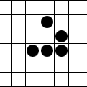
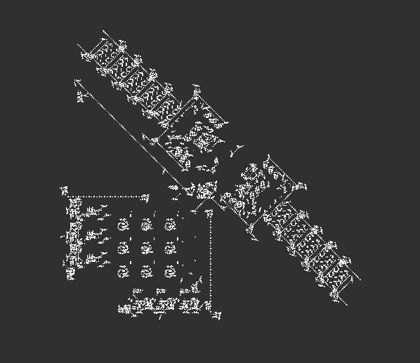
Conway's Game of Life
Three Rules
A live cell survives if it has two or three live neighbors
A new cell is born whenever there are three live neighbors
All other cells either die or remain inactive
“Glider”
Turing machine
[3]

Slide 7
Tree Simulation
Plant age increased by simulation step size
Plant mass increases at linear rate until age of 100 years
Plant mass rapidly decrease until dead at 120 years
Plants spread with a 2D convolution with a 3x3 Kernel of 0.01
Matrix of random values between 0-1 generated
New tree created if random value is bellow convoluted value

Slide 8
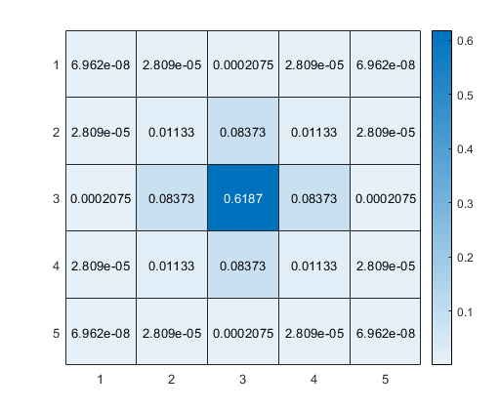
Fire Simulation
Chance of fire is 0.05% each day or ~13 years per fire
Mass matrix element by element multiplied by binary mask of trees on fire
Matrix 2D convolution with 5x5 Gaussian Kernel
Matrix of random values between 0-1 generated
New tree set on fire if random value is bellow convoluted value
5x5 Gaussian Kernel

Slide 9
Fire Prevention Strategies Tested
No protection – Control
Cutting down trees
Starting controlled fire
Over Quenching – Put out majority of fires

Slide 10
Metrics
Average mass burned per fire
Fraction of edges burned per fire
Average acres burned per fire
Average acres burned per 1000 year run

Slide 11

Simulation
Lighter colors is more mass
Over 60 GB data created
2 minutes each to simulate control and over quenching
20 minutes to simulate cutting trees and controlled fire
10 Simulations of 1000 years each
Each square equates to 1 acre

Slide 12
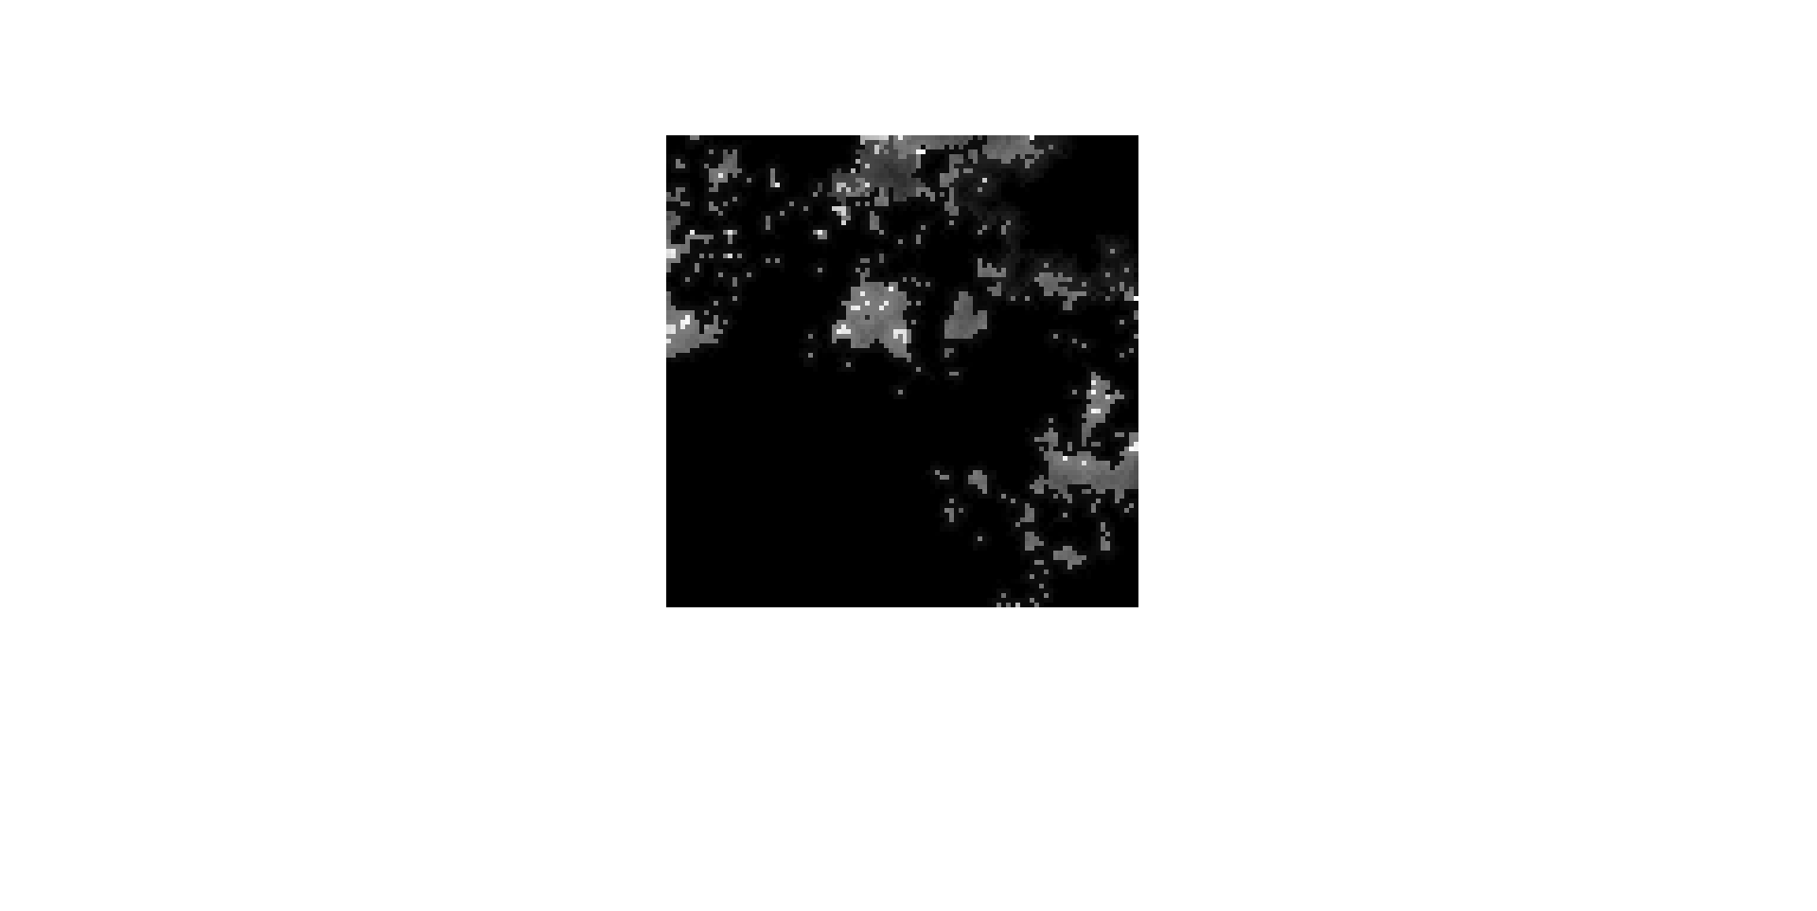

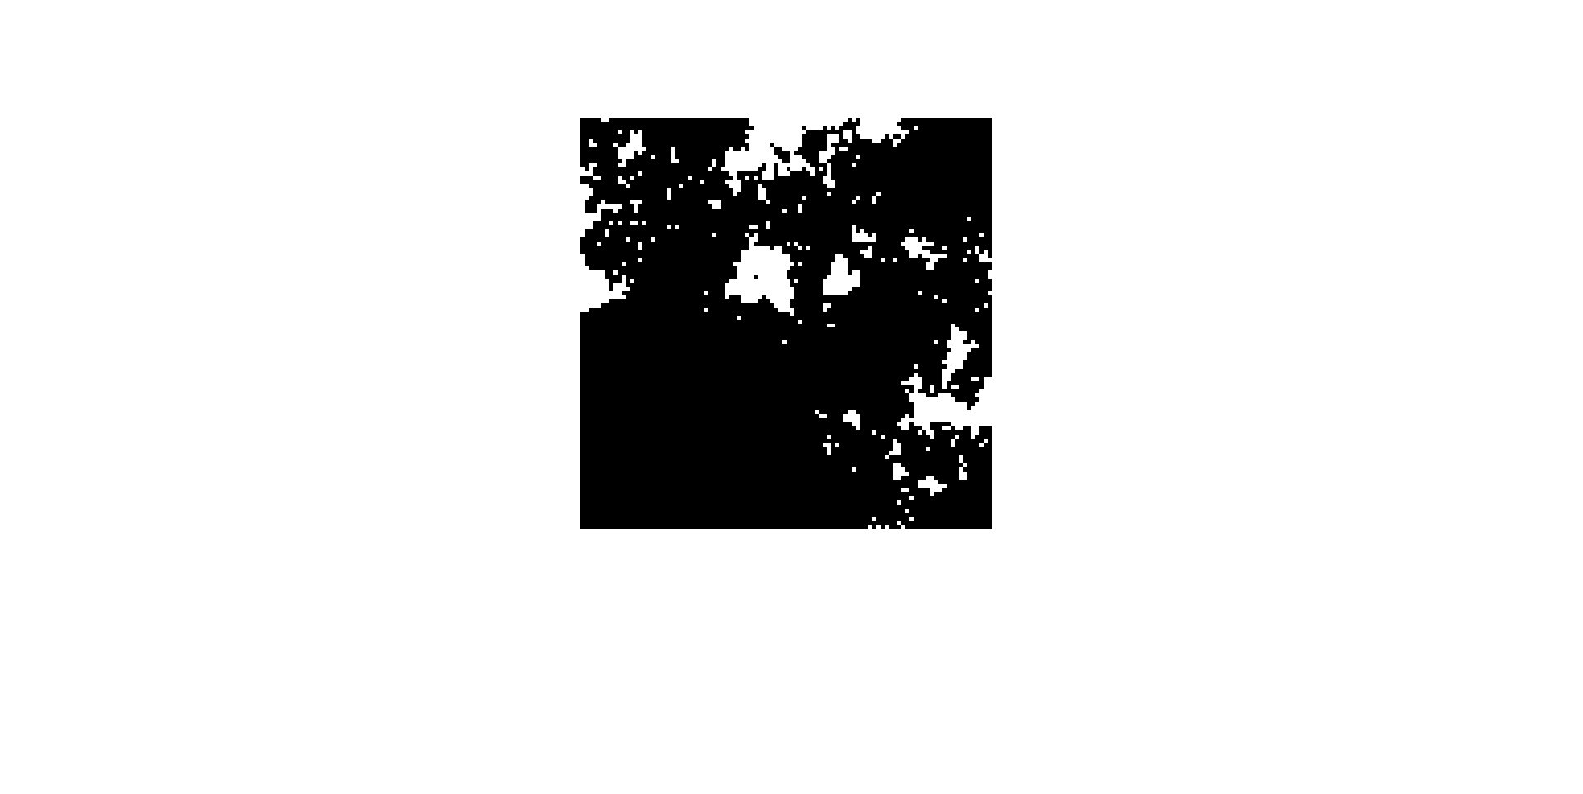
Cutting Trees and Controlled Fire
Original
Threshold at 20% of max mass
Weighted Centroid biggest regions

Slide 13
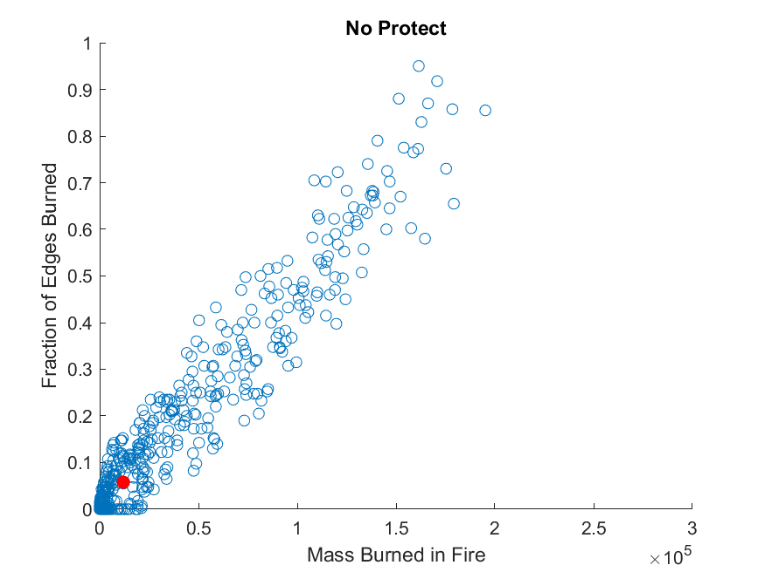
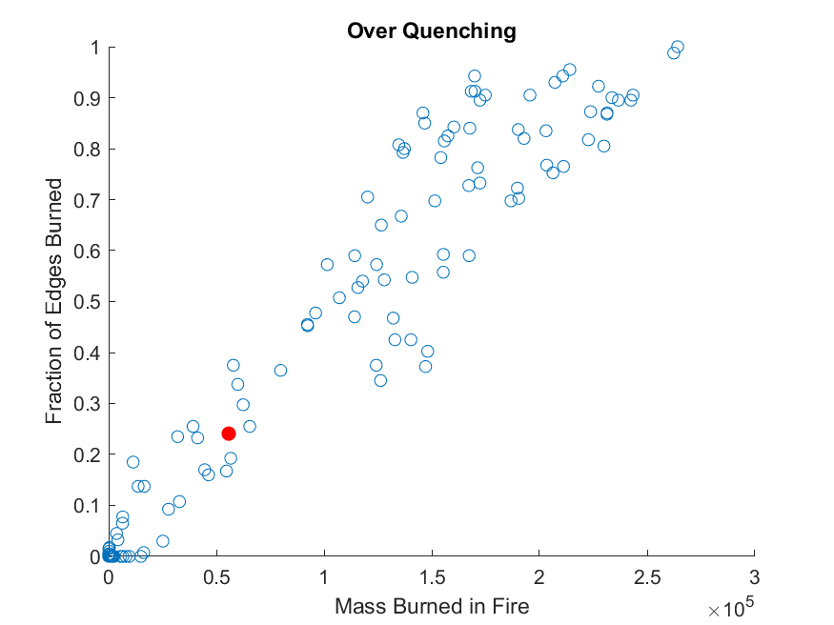
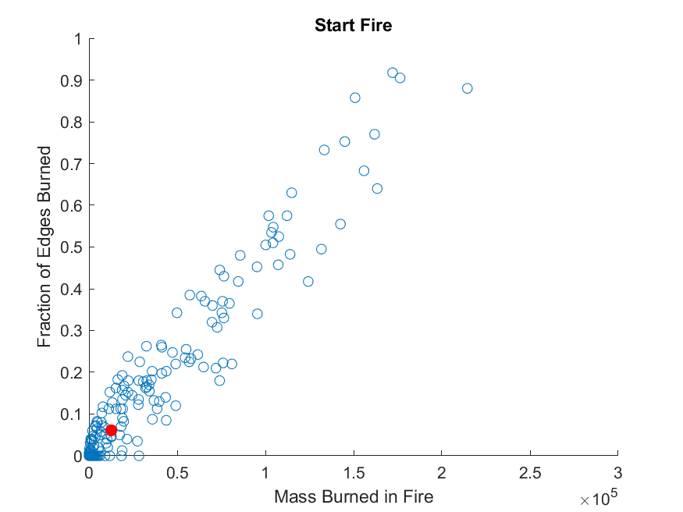
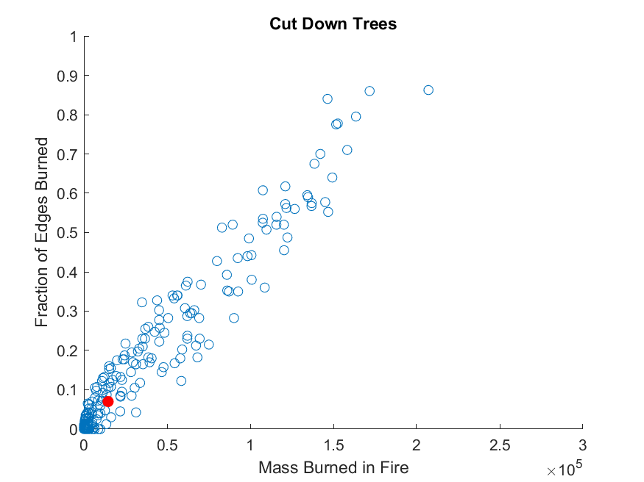
Graphs

Slide 14
Tables
Prevention Strategy | Avg Mass (Metric tons) per Fire | Avg Fraction Edge Burned per Fire | Avg Acres Burned per Fire | Total Acres Burned per 1000 years
Cut Down Trees | 14540±34218 | 0.07±0.16 | 880±1995 | 1.298E5±499
No Protection | 19970±31302 | 0.06±0.15 | 726±1833 | 1.168E5±183
Over Quenching | 55740±80183 | 0.24±0.34 | 2824±3887 | 7.028E4±389
Starting Fire’s | 12640±31562 | 0.06±0.15 | 765±1819 | 1.331E5±606
Uncertainties calculated over all runs combine per strategy

Slide 15
Conclusions
Over quenching increases average fire size but decreases total acres burned over 1000 years
Starting fires is better in average mass burned than no protection but worse in average acres burned

Slide 16
Future Work
Include climate simulation for dry areas vs wet areas
Add biasing of fire spreading due to hills and wind

Slide 17
References
[1] Camp Fire Final report (2018)
[2] https://towardsdatascience.com/types-of-convolutions-in-deep-learning-717013397f4d
[3] A. Adamatzky, Game of Life cellular automata. [electronic
resource]. (Springer, 2010).

Slide 18

2D Convolution
Takes a matrix
Slides kernel over matrix
Kernel is usually a smaller matrix
Zero padded for same size
[2]

Slide 19
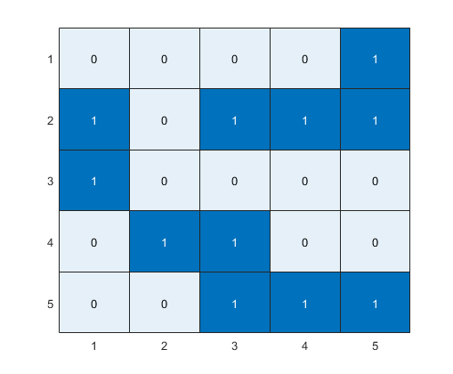
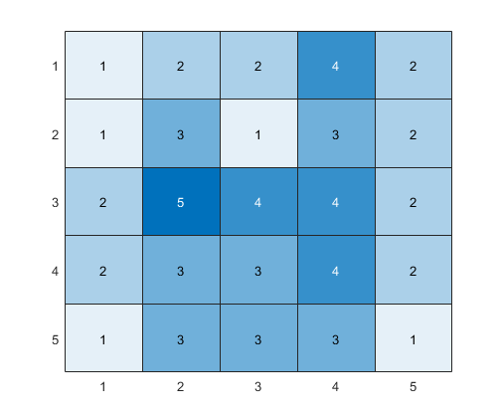
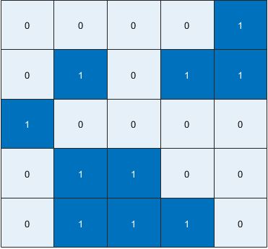
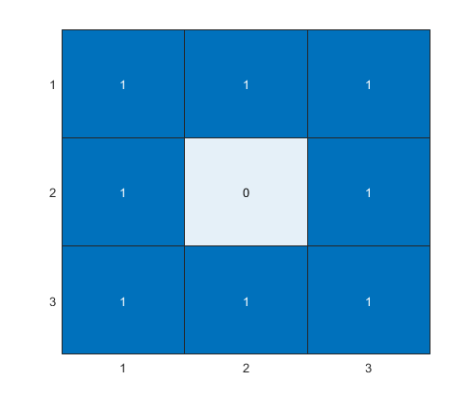
Game of Life Convolution
Kernel
2D Convolution
Initial Game of Life Board
New Board

